Slide 1
高级数据结构和算法分析
Advanced Data Structures and Algorithm Analysis
主讲教师： 陈 昊
Instructor: CHEN, Hao
E-mail: haochen.cad@zju.edu.cn
Courseware and homework sets can be downloaded from https://pintia.cn/

Slide 2
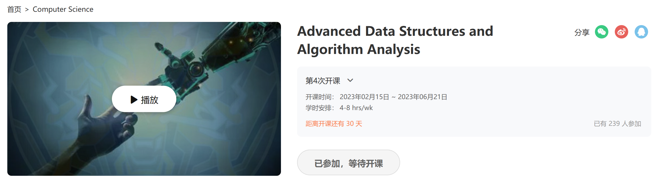
Flipped Classroom
Register at http://www.icourse163.org/course/ZJU1-1460402161
Bilibili: https://www.bilibili.com/video/BV1bE41147ov

Slide 3



 教材 (Text Book)
Data Structures and
Algorithm Analysis in C
(2nd Edition)
Mark Allen Weiss
陈 越 改编
Email: weiss@fiu.edu

Slide 4
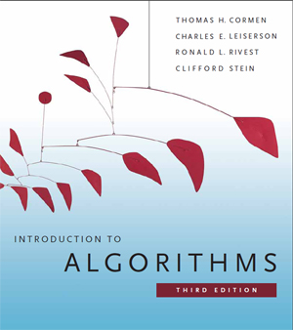
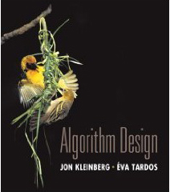
 教材 (Text Book)
Algorithm Design
Jon Kleinberg, Eva Tardos
Addison Wesley, 2005
Introduction to Algorithms
(3rd Edition)
Thomas H. Cormen, Charles E. Leiserson, Ronald L. Rivest and Clifford Stein
The MIT Press. 2009

Slide 5






课程评分方法 (Grading Policies)
Discussions
(10)
Homework (10)
Research Project
+Peer Review (30)
MidTerm
(10*)
Total ≤ 60
Final Exam (40*)
Notes:
期末比期中好，期中不算分。此外有些bonus加分，但平时成绩最多60。期末卷面分数不到40，不能合格。

Slide 6
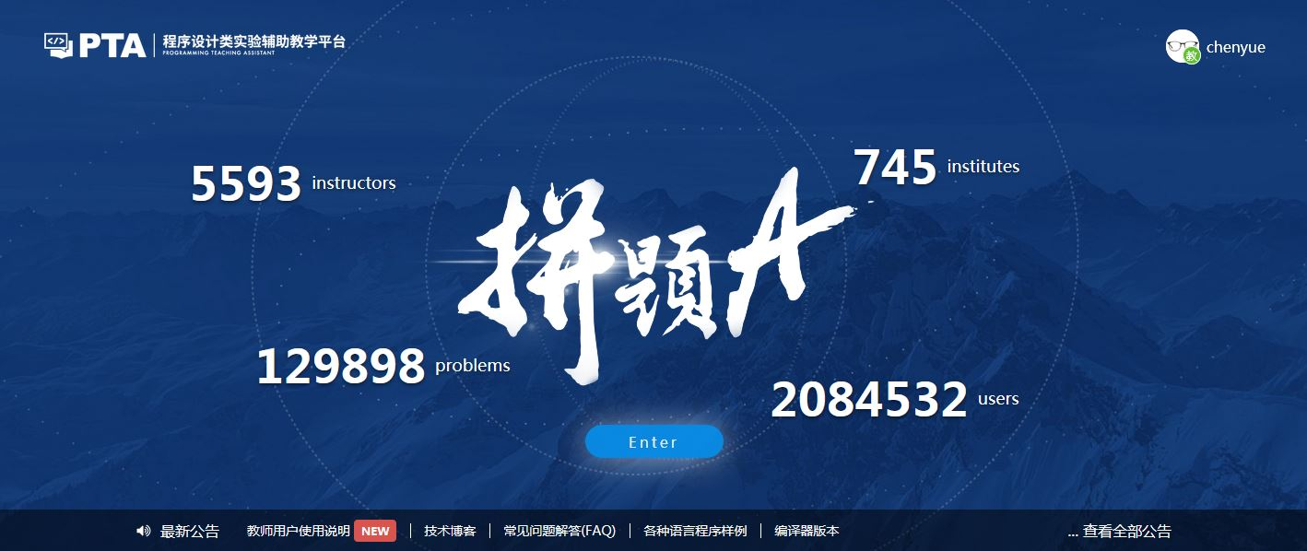
Homework Assignments (5)
https://pintia.cn/

Slide 7
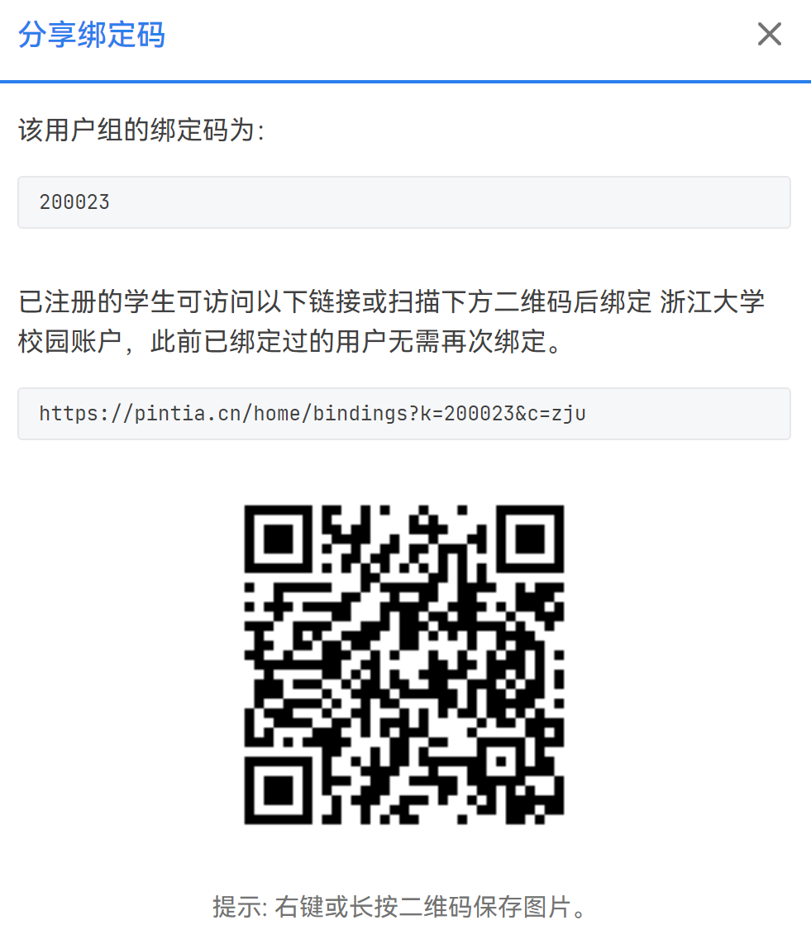
Homework Assignments (10)
BindKey:
200023
Link:
https://pintia.cn/home/bindings?k=200023&c=zju

Slide 8
Discussions (10)
Purpose: make sure that you have understood the lectures
Done in groups of 3 – the group leader submit your answers/solutions online (ddl is 22:00)
You may volunteer to share your answers/ solutions by giving a talk
Gain extra 2pts for each talk for every team member
Notes:
每组3个人，最多可以有两个两人组。讨论10-15分钟。截止时间定在下课后15分钟。

Slide 9
Projects (24 + 6)
Done in groups of 3
Choose at least 2 of 8 topics, (1/10 bonus points will be added for each extra submission > 70%)
Report grade will be the average of your two highest scored
In-class presentation (10~15 minutes, 6 points)
The speaker will be chosen voluntarily from all the contributors
If there are many volunteers, at most 3 groups will be randomly selected to give presentations on the day the topic is released.
For those groups not to give presentations, you will lose 10 points
Notes:
如果做多了，那算presentation

Slide 10
诚信守则
（Code of Academic Honesty）
One must get a full mark to be eligible to take the final exam.
As long as there is one action of academic dishonesty in this semester, one will not be eligible to take the final exam and one’s course score will be zero.
Notes:
课程要求在诚信守则的公告栏里

Slide 11
DingTalk Channel
You are encouraged to ask/answer questions in the public channel
Good questions/answers will be rewarded (1-3 pts)

Slide 12
Exercises
Selected from past exams
Not mandatory
Always open

Slide 13
Discussion for today’s course is released. Deadline is set to 22:00.
Please send your group members’ names and student ID’s to haochen.cad@zju.edu.cn before the discussion closes. In return, you will receive your group ID.
Please specify your group leader in the email.
Notes:
今天有第一个discussion，所有人都可以看到。组长提交就好了。10点前把组长和成员信息发邮件到邮箱。

